Slide 1

Mini Project Report
On AI-Driven VLSI Circuit Optimization.
Submitted by
Roll No.: UI22EC33 ( J.Vivek Sam)
Roll No.: UI22EC36 ( K.P.Thanmay Sai)
Roll No.: UI22EC41 ( M.Koushik)
Under the guidance of
Dr. Tanmay Dubey
Dr. Dhiraj Patel
DEPARTMENT OF ELECTRONICS AND COMMUNICATION ENGINEERING
May , 2025
INDIAN INSTITUTE OF INFORMATION TECHNOLOGY SURAT-394190

Slide 2
AI-Driven VLSI Circuit Optimization: Revolutionizing PPA Trade-offs
This presentation explores AI's transformative potential in VLSI circuit design. Discover how machine learning and genetic algorithms optimize power, performance, and area. We will cover the architecture, methodology, results and potential future applications of this technology.
Understanding the Circuit Design Challenge: Power, Performance, Area
Power
Performance (Delay)
Area
Minimizing power consumption is crucial for efficient circuits. Lower power leads to less heat. It also improves battery life.
High performance means faster circuit operation. Reducing delay enhances processing speed. It also enables real-time computations.
Smaller area reduces chip size and cost. Efficient area usage maximizes component density. Ultimately, this also enables more functionality.

Slide 3

Traditional vs AI-Driven Circuit Optimization Methods
1
Manual Adjustment
Traditional methods involve manual transistor sizing in LTspice. It's time-consuming and relies on expert intuition.
2
Simulation-Based Optimization
Using simulators to evaluate different circuit configurations. Can be slow and computationally expensive.
3
AI-Driven Optimization
AI algorithms automate the transistor sizing process. They efficiently balance trade-offs between PPA.

Slide 4




Machine Learning Architecture for VLSI Optimization
Data Collection
Algorithm Selection
Model Training
Gathering circuit simulation data for training. Ensuring a diverse dataset for robust learning.
Training the ML model with collected data. Fine-tuning parameters for optimal performance.
Choosing the appropriate ML algorithm. Genetic Algorithms and Reinforcement Learning are options.

Slide 5




Implementing Pareto Optimization for Multi-objective Goals
Define Objectives
Generate Solutions
Clearly define power, performance, and area targets.
1
Create a set of potential circuit designs.
2
Select Best Design
4
Evaluate Trade-offs
Choose the design that best meets specific needs.
3
Identify the Pareto front of optimal solutions.

Slide 6







Our project Workflow
Circuit Design in 180nm Tech
LTspice Simulation
Extract PPA Metrics
Dataset Generation
Machine Learning Model Training
Prediction & Optimization
Optimal Transistor Sizing Selection

Slide 7
STEP-1
Digital Circuit Design in LTspice Using 180nm Technology.
Welcome to this presentation on CMOS circuit design using LTspice with 180nm technology. We will cover theoretical foundations, power analysis, and transistor sizing optimization. This step-by-step guide is designed to equip you with the knowledge and practical skills to design efficient and reliable CMOS circuits.
In this presentation, we will explore the fundamental concepts of CMOS technology, starting with the construction and analysis of a CMOS inverter. This foundational knowledge will pave the way for advanced techniques, including the use of AI for transistor sizing optimization. Let's begin!

Slide 8
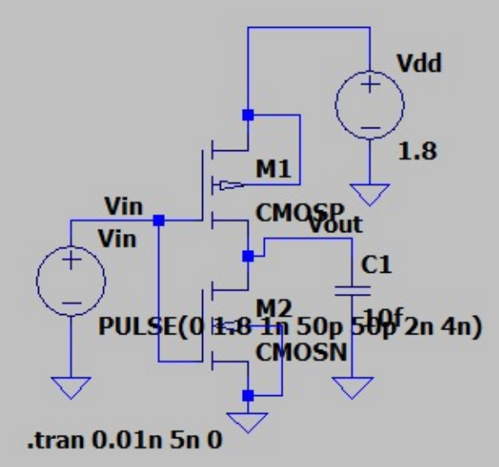
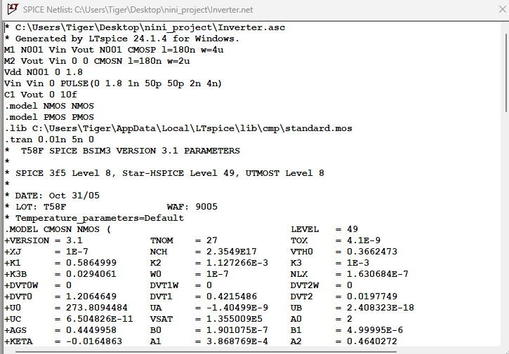
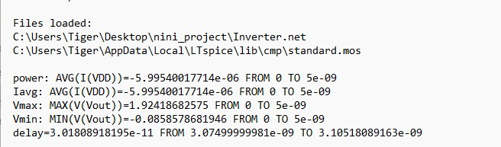
A pseudo-NMOS NOR gate uses one always-on PMOS transistor as a constant pull-up and multiple NMOS transistors for logic evaluation. In
CMOS Inverter
The CMOS inverter is the most basic, yet crucial, component in digital logic design. It consists of two primary transistors: an NMOS (M1) and a PMOS (M2). When the input is HIGH, the NMOS conducts. Conversely, when the input is LOW, the PMOS conducts. A power supply (VDD = 1.8V) energizes the circuit, and a load capacitor (C_L = 10fF) represents parasitic capacitance.
A
Inverter Input netlist
Inverter Circuit
Inverter Output Log File

Slide 9
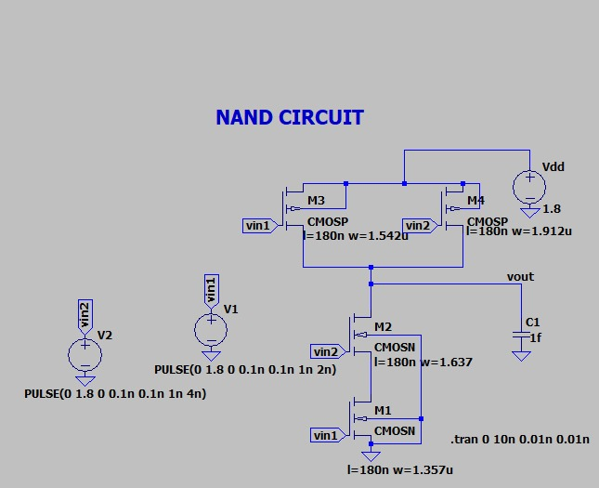
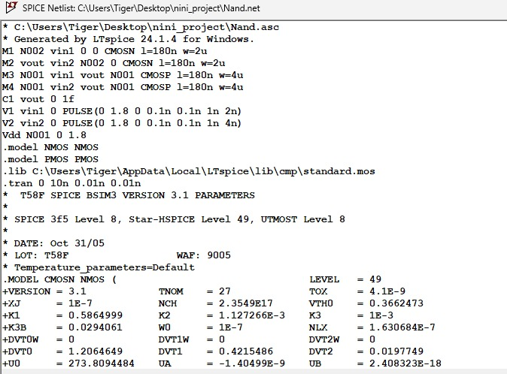
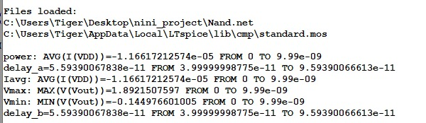
CMOS NAND
standard CMOS NAND gate consists of two PMOS transistors in parallel as the pull-up network and two NMOS transistors in series as the pull-down network. When both inputs are high, the NMOS path conducts and pulls the output low. If either input is low, at least one PMOS conducts, pulling the output high. This ensures full voltage swing and no static power dissipation. CMOS NAND is widely used due to its efficiency and robustness.
NAND Input netlist
CMOS NAND
NAND Output Log File

Slide 10
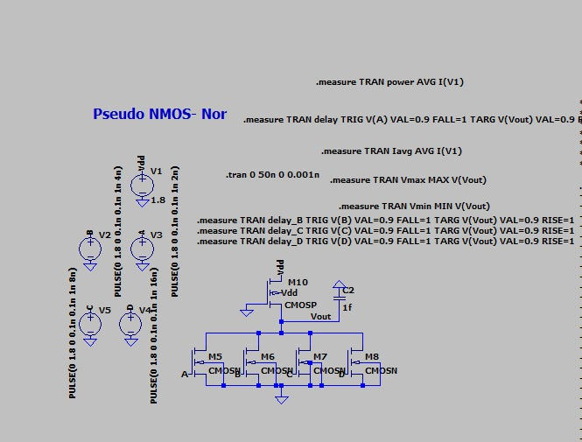
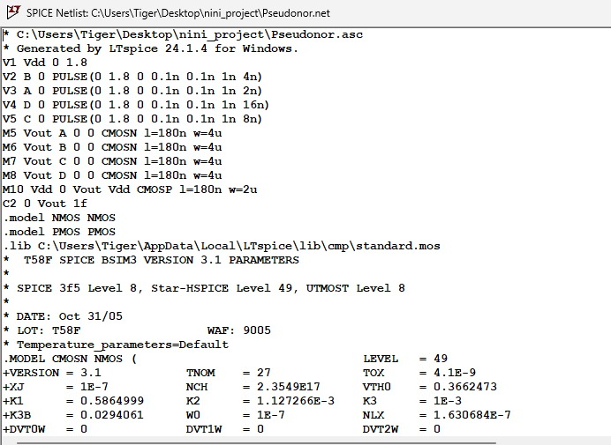
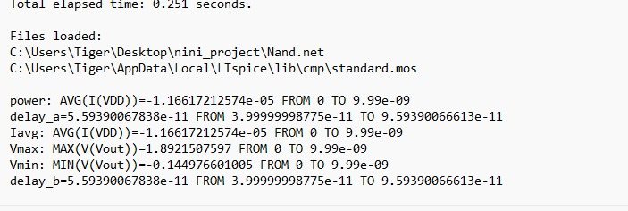
PSEUDO NMOS NOR
A 5-transistor pseudo-NMOS NOR gate uses four NMOS transistors in parallel as inputs and a single PMOS transistor as a pull-up connected to VDD. When all NMOS inputs are low, they are off, and the PMOS pulls the output high. If any NMOS input is high, that transistor turns on, pulling the output low against the weak PMOS pull-up. This configuration reduces the transistor count compared to a standard CMOS NOR but introduces static power dissipation when the output is low. The output low voltage isn't a full ground due to the PMOS pull-up's resistance.
NOR Input netlist
PSEUDO NMOS NOR CIRCUIT
NOR Output Log File

Slide 11
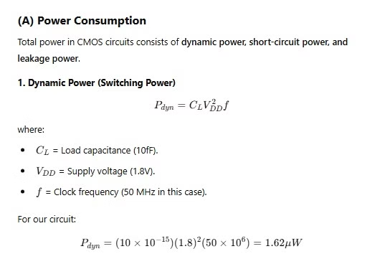
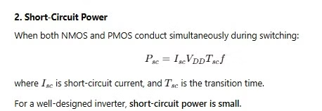
Power Consumption in CMOS Circuits
This presentation delves into the critical aspects of power consumption in CMOS (Complementary Metal-Oxide-Semiconductor) circuits, a cornerstone of modern digital electronics. We will explore the primary components of power dissipation: dynamic power, short-circuit power, and leakage power. Understanding these elements is essential for designing efficient, high-performance integrated circuits.
Dynamic Circuit Power Dissipation
Dynamic power, also known as switching power, is the power consumed when charging and discharging the load capacitance during transistor switching. It's a dominant factor in CMOS circuits. The formula is P_dyn = C_L V_DD² f, where C_L is the load capacitance, V_DD is the supply voltage, and f is the switching frequency.
Short-Circuit Power Dissipation
Short-circuit power arises when both the NMOS and PMOS transistors conduct simultaneously during the
switching transition. This temporary conduction path from V_DD to ground results in wasted power.

Slide 12
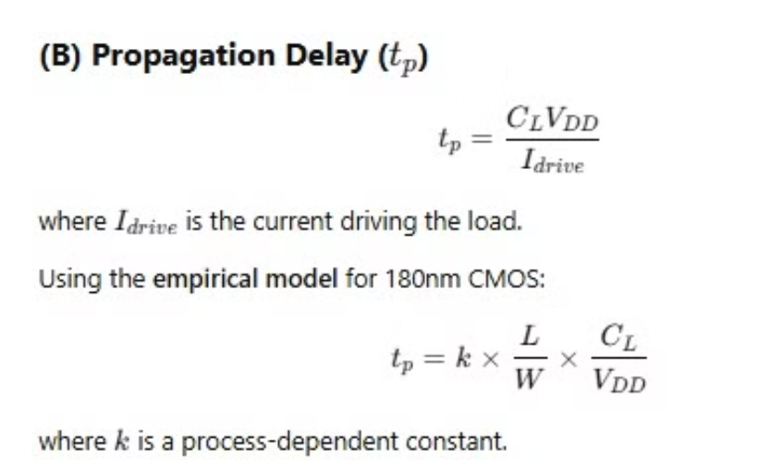
Understanding Propagation Delay (t_p)
1
Delay Determination
2
Formula for Delay
The propagation delay, denoted as t_p, is primarily governed by the switching speed of the transistor. This parameter is critical as it dictates the maximum operational frequency of a digital circuit.
The delay is mathematically expressed as t_p = C_L V_DD / I_drive, where C_L is the load capacitance, V_DD is the supply voltage, and I_drive is the drive current. This formula highlights the key factors influencing circuit speed.
3
Empirical Model (180nm CMOS)
4
Transistor Size Trade-off
For 180nm CMOS technology, the propagation delay can be approximated using an empirical model: t_p = k × (L/W) × (C_L / V_DD). This model provides practical insights into transistor sizing and performance.
Smaller transistors reduce delay, enabling faster switching speeds. However, this reduction often comes at the cost of increased leakage power, necessitating a careful balance in design choices.

Slide 13
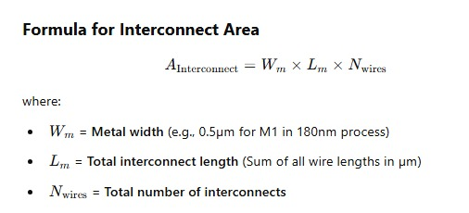
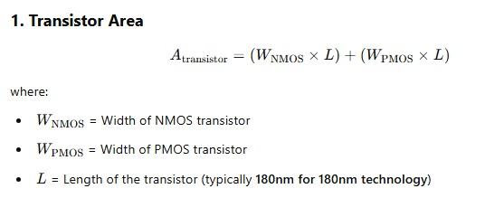
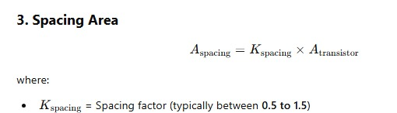
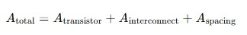
Circuit’s Area Estimation
Total Transistor Area
1
The total transistor area in a CMOS inverter is calculated as the sum of the areas of the NMOS and PMOS transistors:
Total Area = A-Tran + A-Interconnect + A-Spacing.
2
Design Example
In a typical design example, with W_n = 0.5µm, L_n = 0.18µm, W_p = 1µm, and L_p = 0.18µm, the total area A = (0.5 × 0.18) + (1 × 0.18) = 0.27µm². This provides a tangible understanding of area occupation.
Key Takeaway
3
Increasing the width (W) of the transistors improves the switching speed but also leads to an increase in the overall area and power consumption. This trade-off is a critical consideration in CMOS inverter design.

Slide 14
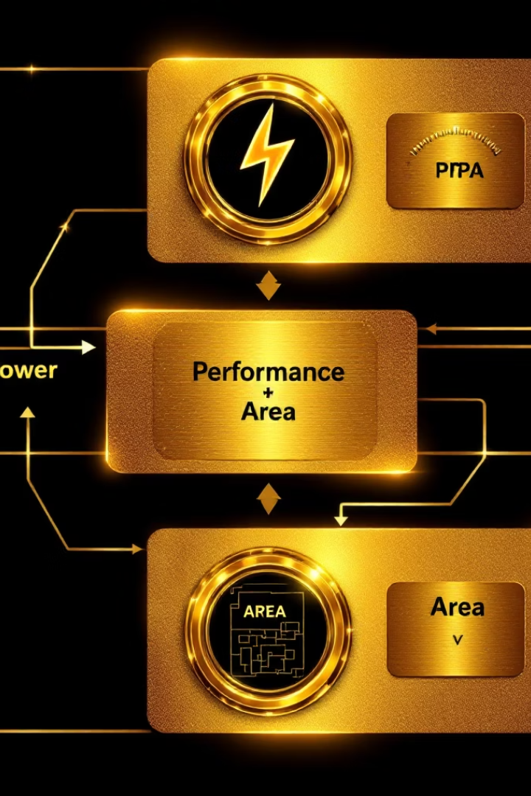
PPA Trade-Off in VLSI Design
The Power, Performance (Delay), and Area relationship in VLSI design forms a fundamental triangle where improving one aspect negatively affects the others. Power refers to the energy consumption, performance relates to the circuit speed or delay, and area defines silicon real estate used. Designers must navigate these trade-offs to meet system requirements effectively.
Area vs Delay
For example, increasing transistor size generally reduces delay by enhancing drive current but comes at the cost of higher area and power penalties. Understanding these interactions is crucial to creating efficient, optimized VLSI circuits.

Slide 15
Interdependencies Among PPA Metrics
Area ↔ Power
Delay ↔ Power
Expanding transistor size increases dynamic and leakage power due to higher capacitance and more devices. Conversely, shrinking transistor size can reduce power but may degrade performance due to higher delay.
Reducing delay through larger transistors raises both area and dynamic power consumption, including short-circuit power during transitions. Power reduction techniques, such as lowering supply voltage, typically increase delay, impacting speed.
Designers operate within this delicate balance, prioritizing aspects depending on application needs—high-speed circuits tolerate more power and area, while low-power designs often compromise on delay and size.

Slide 16
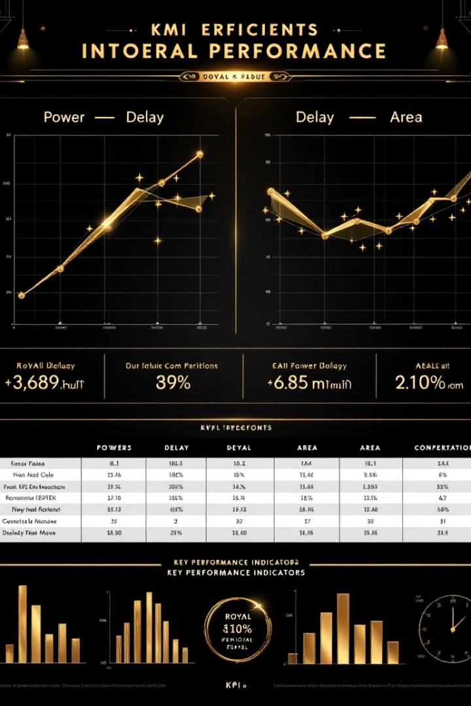
PPA Trade-Off Summary and Design Strategy
Change
Power Impact
Delay Impact
Area Impact
Increase size
Increase power
Reduce delay (better)
Increase area
Reduce size
Decrease power (leakage)
Increase delay
Reduce area
Optimize delay
Increase power (usually)
Reduce delay
Increase area (often)
Reduce power
Decrease power
Increase delay
Reduce area (depends)
The key insight for VLSI engineers is that enhancing one metric generally degrades others. Effective design requires balancing these trade-offs by analyzing application constraints and performance targets, leading to an optimized silicon implementation that meets system goals.

Slide 17
STEP-2
Extraction and Generation of CMOS Circuits Dataset with Parametric Variations for AI-Optimization
This presentation outlines the methodology for creating a comprehensive dataset tailored for AI-driven optimization of CMOS circuit designs. We employ parametric variations and LTspice simulations to capture a wide range of performance characteristics. This dataset aims to facilitate the training of robust AI models capable of optimizing inverter designs for various performance metrics. The approach involves automated data extraction, the introduction of variability, and detailed performance parameter computation. The ultimate goal is to enhance design efficiency and performance through AI-driven methodologies.
Dataset Generation for AI-Driven Optimization
Parametric Variations
LTspice Simulations
The core of our approach lies in generating a dataset through systematic parametric variations. By manipulating key design parameters, such as transistor widths, we can explore the design space and capture the corresponding performance characteristics. This method enables a comprehensive understanding of the relationships between design parameters and inverter performance, which is essential for AI model training.
We leverage LTspice simulations to collect performance metrics from different circuit configurations. LTspice provides accurate circuit simulation capabilities, allowing us to measure power consumption, delay, and area effectively. These simulation results form the basis of our dataset, providing the necessary information for AI model training and optimization. The accuracy of LTspice ensures reliable performance data.

Slide 18



Key Performance Parameters (PPA)
1
Power Consumption
2
Delay
3
Area
Power consumption is a critical metric extracted as the average current drawn from VDD. Minimizing power is essential for energy-efficient designs.
Delay, measured as the time difference between the input switch and output response, dictates the inverter's speed. Lower delay values indicate faster performance.
Area is estimated as the product of transistor width and length (W×L). Smaller areas contribute to higher integration density and lower costs.
Extracting Power and Delay from LTspice Log
Log File Analysis
Power Extraction
Delay Extraction
The LTspice simulation generates a detailed log file containing vital circuit performance data. This file serves as the primary source for extracting power and delay values, ensuring accuracy and efficiency in data collection.
The power value is precisely extracted from the line containing "AVG(I(VDD))", which represents the average supply current. This metric is crucial for evaluating the energy efficiency of the CMOS inverter design.
The delay value is extracted from the line containing "delay=", which represents the propagation delay. This parameter is essential for assessing the speed and performance of the inverter circuit.
The LTspice simulation generates a log file containing circuit performance data. The power value is extracted from the line that contains "AVG(I(VDD))", which gives the average supply current. The delay value is extracted from the line that contains "delay=", which represents the propagation delay.

Slide 19



Generating a Large Dataset for AI Model Training
Sample Generation
NMOS Width
PMOS Width
To ensure the AI model can learn effectively, we generate a large dataset comprising at least 2000 samples with varying transistor widths. This volume of data is crucial for training a robust and accurate AI model.
The NMOS width (Wn) is randomly selected from a predefined range of 0.1 µm to 2.5 µm, based on 180nm technology. This range allows for sufficient variation in the NMOS transistor characteristics.
The PMOS width (Wp) is randomly chosen from a predefined range of 0.2 µm to 5.0 µm, based on 180nm technology. This wider range accommodates the different performance requirements of the PMOS transistor.

Slide 20



Area Estimation and Variation Introduction
2
CMOS Variations
1
Area Estimation
3
Realistic Data
The area of the inverter is estimated as Area = (Wn + Wp) * 0.1, with transistor length fixed at 180nm, making width the dominant factor. CMOS fabrication variations, such as doping concentration, oxide thickness, and lithography precision, necessitate the introduction of variations in power and delay to reflect real-world conditions accurately. Without these variations, the dataset would be too idealized and fail to capture the complexities of real-world circuit performance under fluctuating temperature and supply voltage.

Slide 21
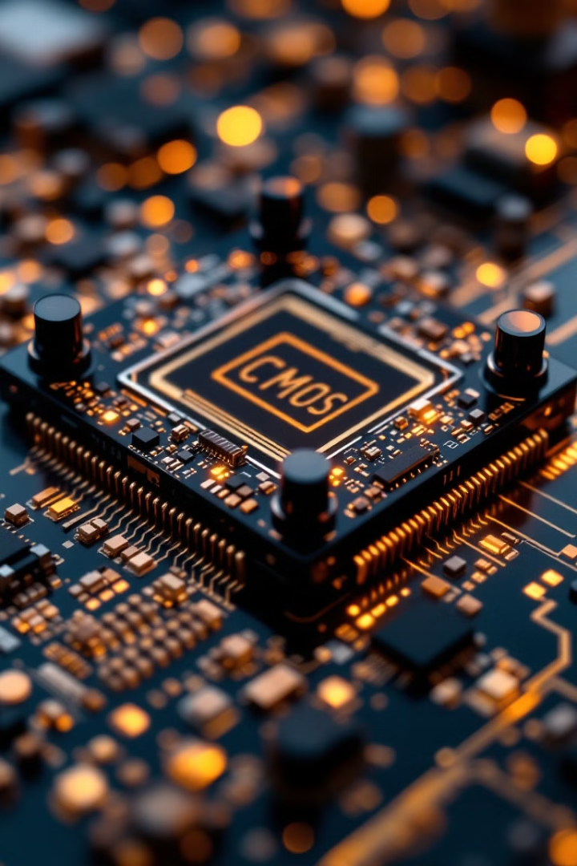
AI-Driven Transistor Sizing Optimization
This presentation will guide you through the data generation process for AI/ML-based CMOS optimization. We'll cover output file specifics and future optimization steps.
Expected Outcomes & Steps
1
Outcome
Dataset ready for AI/ML analysis.
Understand parameter trade-offs.
2
Next Step
Training ML model (step 3), Apply Pareto optimization (Step 4).
Find the best transistor sizing.

Slide 22
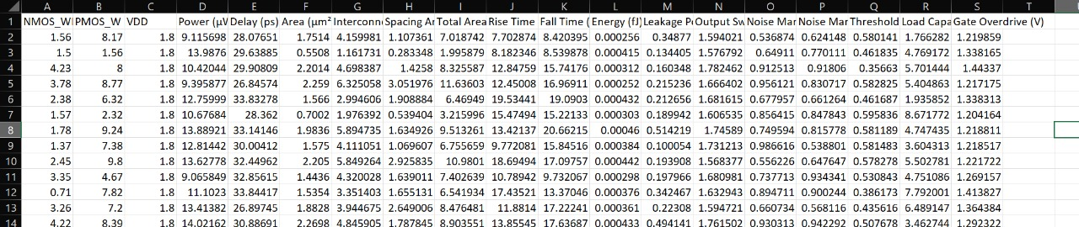
Final Outcome of Step 2
1
CSV File
2000+ samples: transistor widths, power, delay, and circuit parameters.
2
Realistic Data
Captures process variations accurately.
3
Strong Foundation
Enables AI-based Pareto optimization of circuits.
FOR CMOS Inverter
Sample dataset

Slide 23
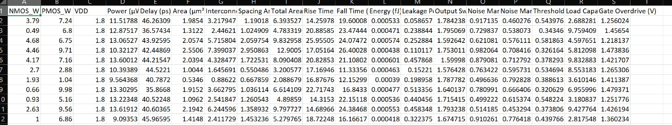
FOR CMOS NAND
Sample dataset
FOR PSEUDO NMOS NOR
Sample dataset

Slide 24
STEP-3 ML Model for PPA Prediction
In this presentation, we'll explore training a machine learning (ML) model to predict Power, Performance, and Area (PPA) in circuit design. Traditionally, this requires extensive simulations. Our ML model learns the relationship between transistor sizing and circuit performance, enabling faster estimations and AI-driven optimization. This approach allows us to explore multiple design choices efficiently, sidestepping the need for manually adjusting parameters. Let’s dive into how we can achieve this.
Benefits of ML-Based PPA Prediction
Speed and Efficiency
Design Exploration
AI-Driven Optimization
Quickly estimate power, delay, and area without rerunning simulations. This saves significant time and computational resources.
Explore multiple design choices without manually adjusting parameters, allowing for rapid prototyping and experimentation.
Use AI-driven optimization to automatically find the best transistor sizing, enhancing overall circuit performance.

Slide 25




Loading and Preparing Simulation Data
We use the extracted data from LTspice simulations. This data contains different transistor widths and their corresponding power, delay, and area values.
This dataset is stored in a CSV file (ltspice_data.csv), making it easily accessible for training our ML model.
The ML model learns the relationship between transistor sizing and circuit performance.

Slide 26
Random Forest Regression
Random Forest Regression is a supervised learning algorithm. It is used for predicting continuous values. This algorithm combines multiple decision trees. By averaging their predictions, the accuracy is improved and overfitting is reduced.
How Random Forest Works
Bootstrapping
Train Multiple Trees
Aggregate Predictions
The dataset is randomly split. Subsets use bootstrapping, or sampling with replacement. Each subset trains a different decision tree.
Each tree is independently trained. Training occurs on a different data subset. Trees predict based on diverse feature sets. This improves generalization.
The final prediction averages all tree outputs. This reduces variance and improves stability for more reliable outcomes.

Slide 27
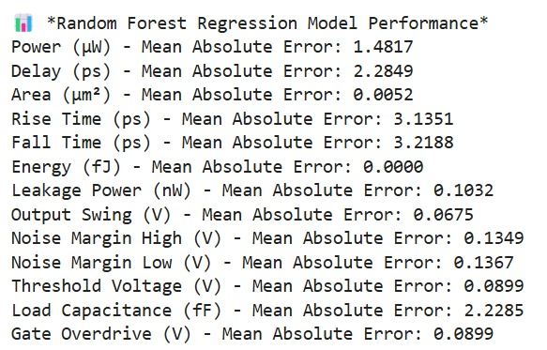
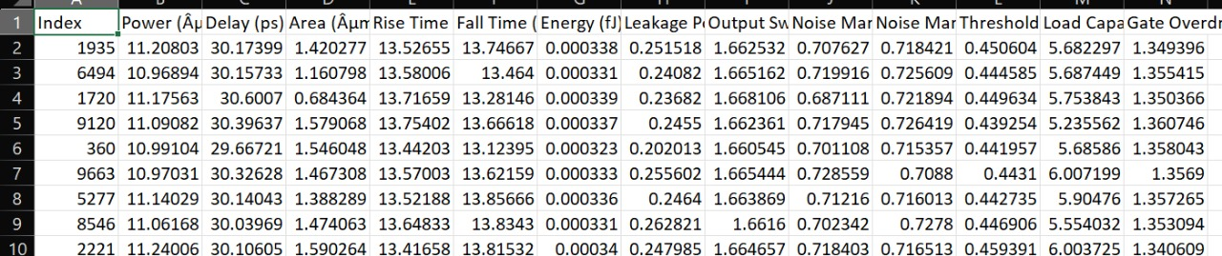
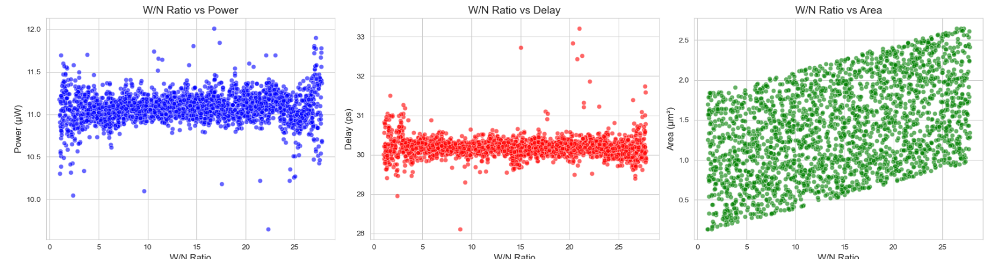
CMOS Inverter using Random Forest.
Key Features & respective outcomes
Handles Non-Linearity
Feature Importance
Robust to Outliers
Scalability
ML Model (RF) Output
ML Model (RF) Predicted Dataset
W/N vs power plot
W/N vs delay plot
W/N vs area plot

Slide 28
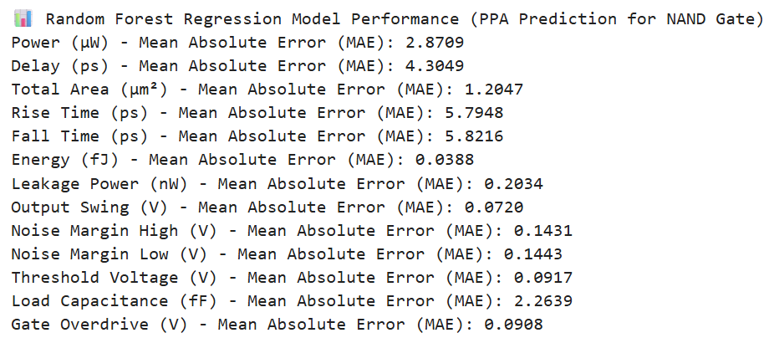
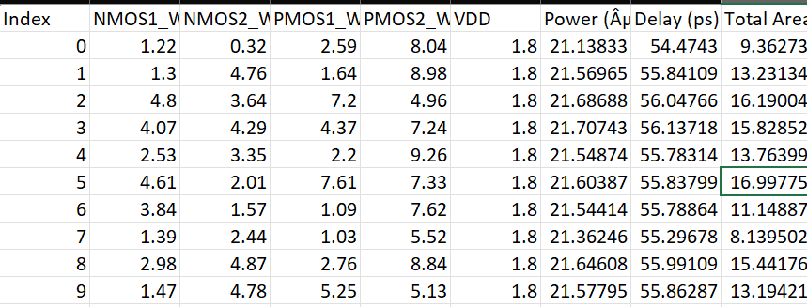
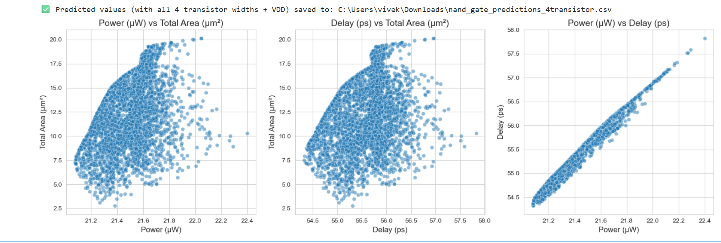
CMOS NAND using Random Forest.
ML Model (RF) Output
ML Model (RF) Predicted Dataset
Power vs Total Area plot
Delay vs Total Area plot
Power vs Delay plot

Slide 29
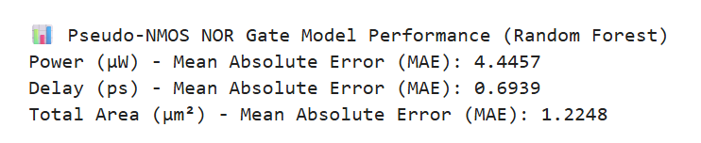
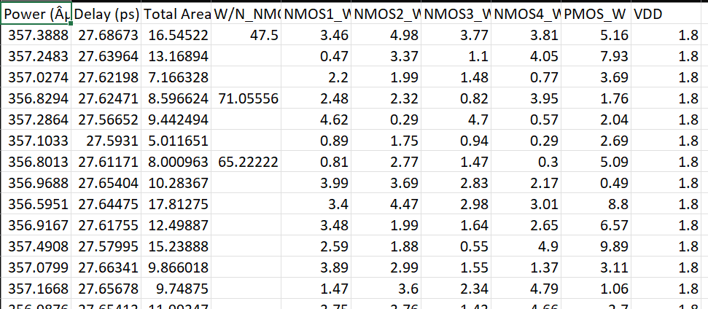
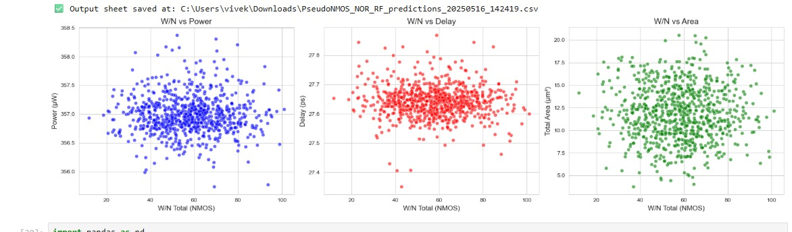
For PSEUDO NMOS NOR Circuit Using Random Forest
ML Model (RF) Output
ML Model (RF) Predicted Dataset
W/N vs power plot
W/N vs delay plot
M W/N vs Area plot

Slide 30
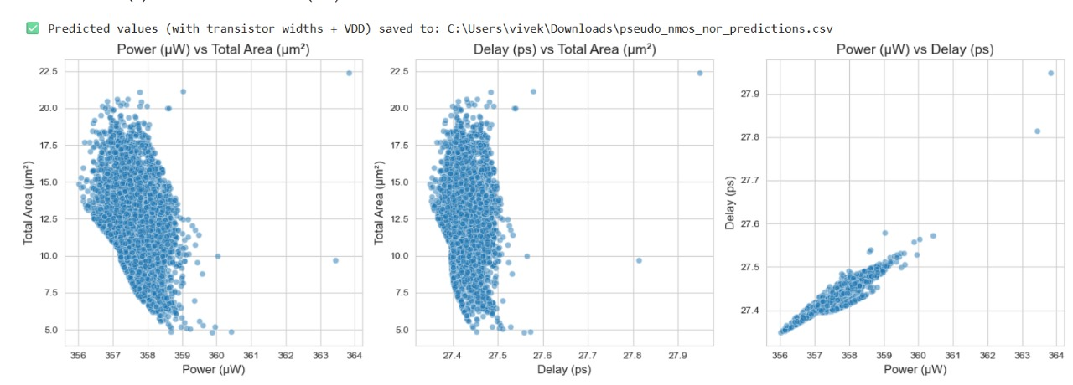
Area vs power plot
Delay vs Area plot
Delay vs power plot
For this project, Random Forest regression models were effectively utilized to predict key performance metrics—power, delay, and area—for three distinct CMOS circuits: the CMOS inverter, CMOS NAND gate, and pseudo-NMOS NOR gate. The use of Random Forest enabled capturing complex nonlinear relationships between transistor widths and circuit characteristics with high accuracy. Comparative analysis across the circuits highlighted how device sizing impacts performance differently depending on the circuit topology. This approach demonstrated the potential of machine learning in accelerating VLSI design optimization by providing fast and reliable predictions. Overall, the integration of Random Forest models offers a robust framework for multi-objective optimization in advanced CMOS circuit design.

Slide 31

Neural Networks in VLSI Optimization
This presentation explores the potential of neural networks to revolutionize the way we optimize VLSI circuits, focusing on their ability to improve performance, power consumption, and area utilization.
Introduction to Neural Networks in VLSI Optimization
What is a Neural Network?
Why Neural Networks for VLSI?
A computational model inspired by the human brain, consisting of layers of neurons that learn patterns from data.
Traditional transistor sizing and circuit optimization rely on trial and error. Neural networks automate and improve efficiency in Power, Performance, and Area (PPA) optimization.

Slide 32
Benefits of Using
Neural Networks
Neural Network Architecture for VLSI Optimization
Pattern Recognition
Input Layer
Learns from past circuit simulations to predict
optimal transistor sizes.
Features: NMOS Width, PMOS Width, VDD, etc.
High Accuracy & Efficiency
Hidden Layers
Reduces design time compared to manual tuning.
Extracts important relationships between transistor parameters.
Output Layer
Nonlinear Problem Solving
Predicts Power, Delay, and Area (PPA metrics).
Captures complex relationships between power, delay,
and area in CMOS circuits.
Training Process
Uses data from LTspice simulations to refine model predictions.
Scalability
Can handle large datasets and multiple circuit configurations.

Slide 33

Comparison with Other ML Techniques
Linear Regression
Low
Low
Cannot capture nonlinear circuit behaviors
Random Forest
Medium
Medium
Requires feature engineering
Support Vector Machine (SVM)
Medium
High
Good for classification, but complex for regression
Neural Networks
High
Medium-High
Best for learning nonlinear power-delay-area trade-offs

Slide 34
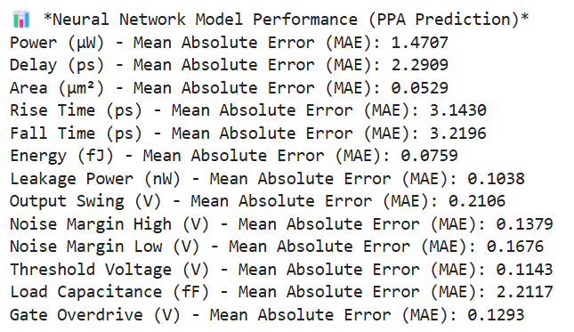
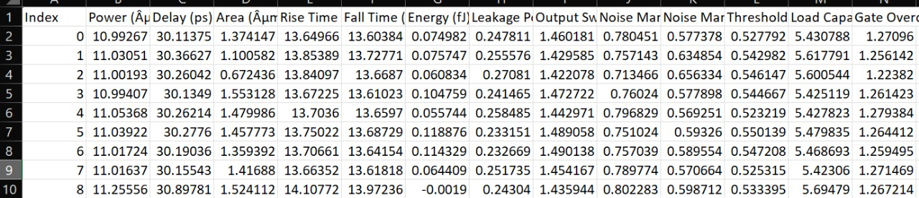
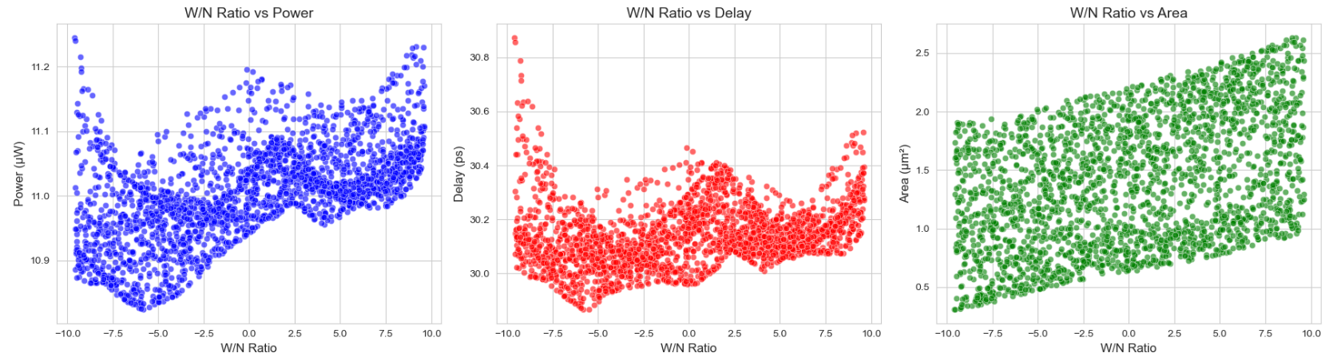
CMOS Inverter using Neural Network.
Scalable & Adaptable
Handles Complex Dependencies
Automates Optimization
Improves Prediction Accuracy
ML Model (NN) Output
ML Model (NN) Predicted dataset
W/N vs power
W/N vs Delay
W/N vs Area

Slide 35
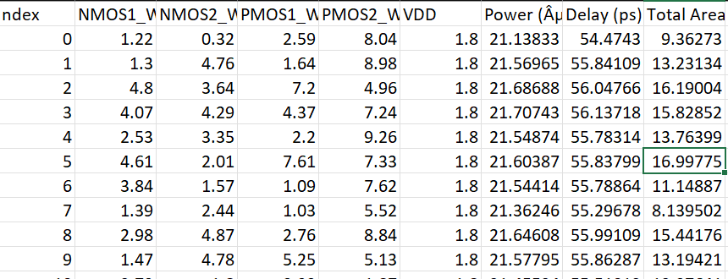
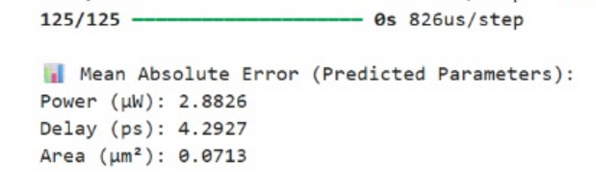
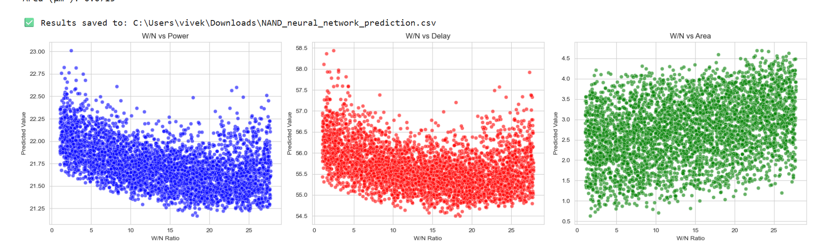
CMOS NAND using Neural Networks
ML Model (NN) Output
ML Model (NN) Predicted dataset
W/N vs Delay
W/N vs power
W/N vs Area

Slide 36
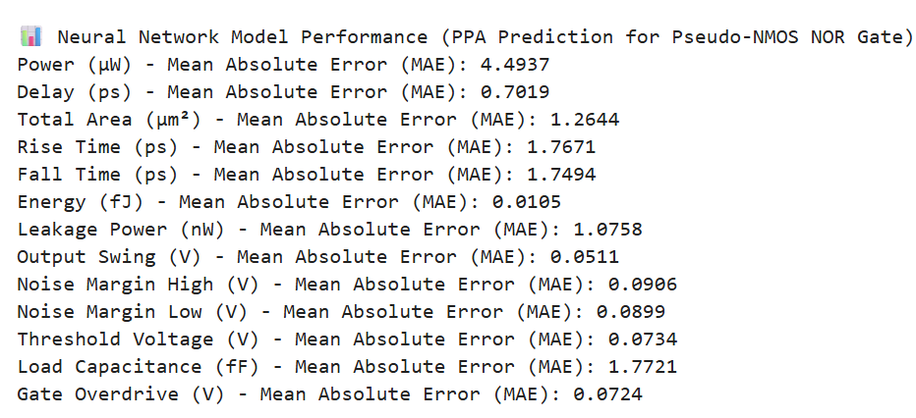
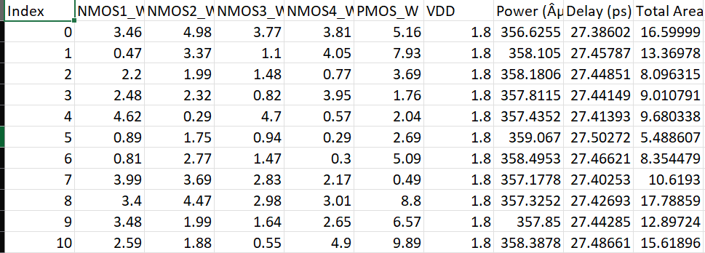
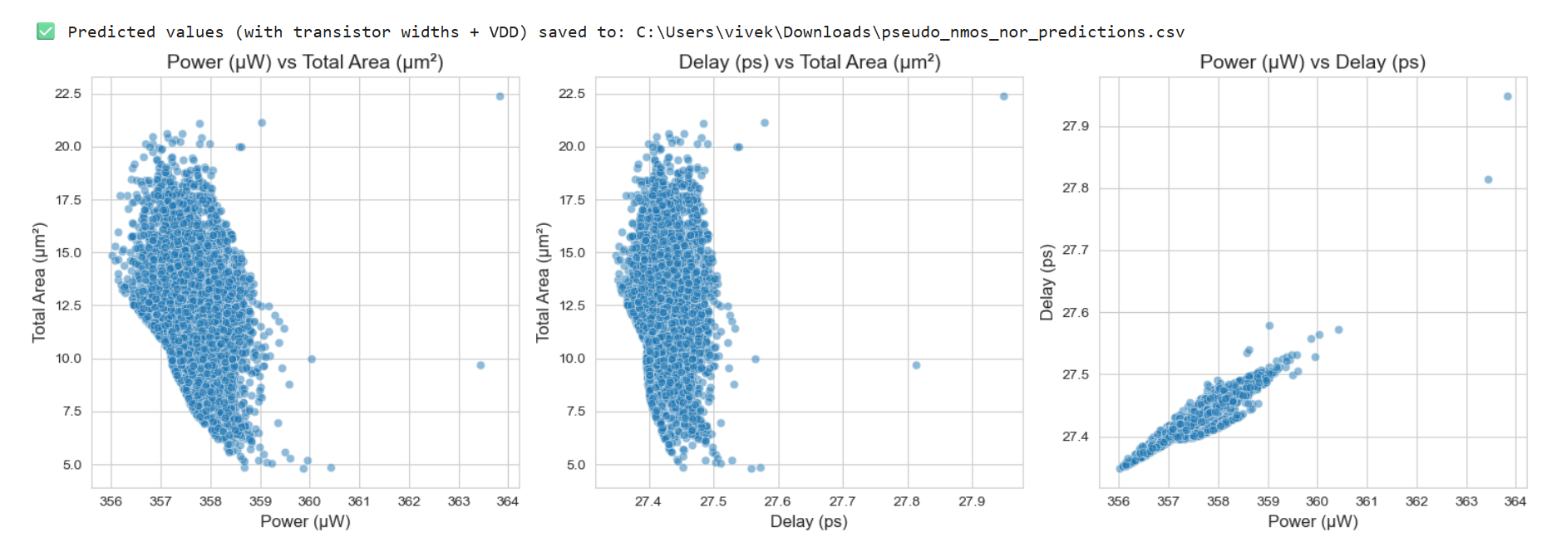
For PSEUDO NMOS NOR Circuit Using Neural Networks
ML Model (NN) Output
ML Model (NN) Predicted datset
Area vs power plot
Delay vs Area plot
Delay vs power plot

Slide 37
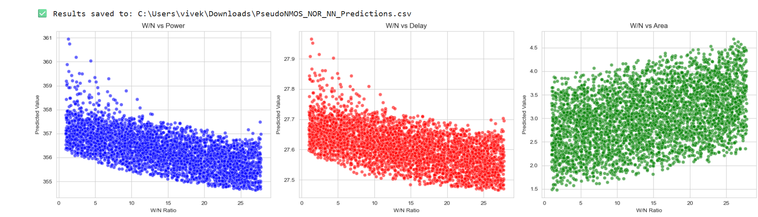
W/N vs power plot
W/N vs delay plot
M W/N vs Area plot
In this project, neural networks were employed to model the performance metrics—power, delay, and area—of CMOS inverter, CMOS NAND, and pseudo-NMOS NOR circuits. Compared to Random Forest, neural networks showed superior capability in capturing highly nonlinear and complex relationships in the transistor sizing data, resulting in more accurate and generalizable predictions. Their ability to learn intricate feature interactions makes them particularly well-suited for modeling subtle device behaviors across different circuit topologies. This improved precision enables more effective design space exploration and optimization. Consequently, neural networks offer a powerful alternative to Random Forests for advanced VLSI circuit performance prediction and optimization tasks.

Slide 38

Why We Used These Models?
Random Forest
Neural Networks
Efficient for small datasets
Generalize better for larger datasets
Faster speed
Higher accuracy
Better scalability
Evaluating Model Accuracy
Mean Absolute Error (MAE)
Root Mean Square Error (RMSE)
R² Score
Used to validate predictions against actual LTspice results
Used to validate predictions against actual LTspice results
Used to validate predictions against actual LTspice results
What we have Obtained From Step 3
We have Obtained the predicted values and graphs of Power vs delay, Power vs area and
Delay vs Area for both the Model

Slide 39

Scalability for More Complex Circuits
1
Generalization Beyond CMOS Circuits
ML models generalize beyond CMOS inverters, aiding the optimization of sequential circuits, memory elements, and arithmetic circuits.
Expected Outcome
1
Trained ML model for accurate power, delay, and area prediction
2
Eliminates repetitive simulations
3
Enables AI-driven circuit optimization

Slide 40



Step 4: Pareto Optimization for Circuit Design
Introduction to Pareto
Optimization
Multi-objective Optimization
Implementation
1
The concept and principles behind Pareto optimization for VLSI design
2
Multi-objective optimization is crucial for balancing power, performance, and area in VLSI design.
3
Applying Pareto optimization
principles to circuit design problems
Concept of the Pareto Front
Instead of one 'best' solution, Pareto optimization identifies a set of trade-offs between power, delay, and area.
Generate Candidate Solutions
Multiple circuit configurations are generated with varying parameters
Evaluate Using ML Model
Candidates are evaluated using the trained ML model for performance metrics
Filter Optimal Configurations
Non-dominated solutions are identified to form the Pareto front

Slide 41




Role of ML in Pareto Optimization
Predict Metrics
Reduce Simulations
ML model predicts performance metrics
1
Reduces need for exhaustive LTspice simulations
2
Feedback Loop
4
Optimize Design
Results inform next generation of designs
3
Enables faster design space exploration

Slide 42




Benefits of Using Pareto Optimization
Faster optimization
Maintains accuracy
Identifies best trade-offs
Dramatically reduces the time needed to find optimal circuit configurations
Delivers reliable results comparable to traditional simulation methods
Finds optimal solutions without exhaustive simulations

Slide 43
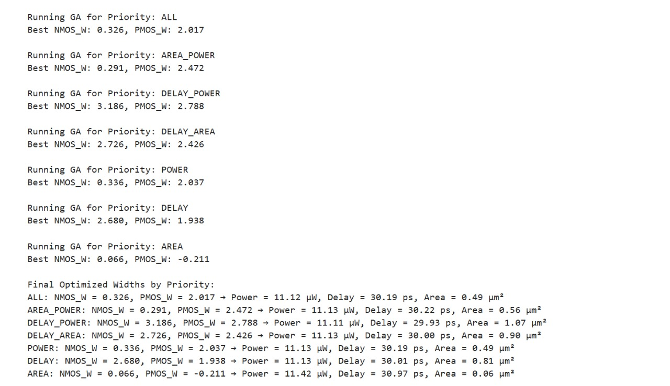
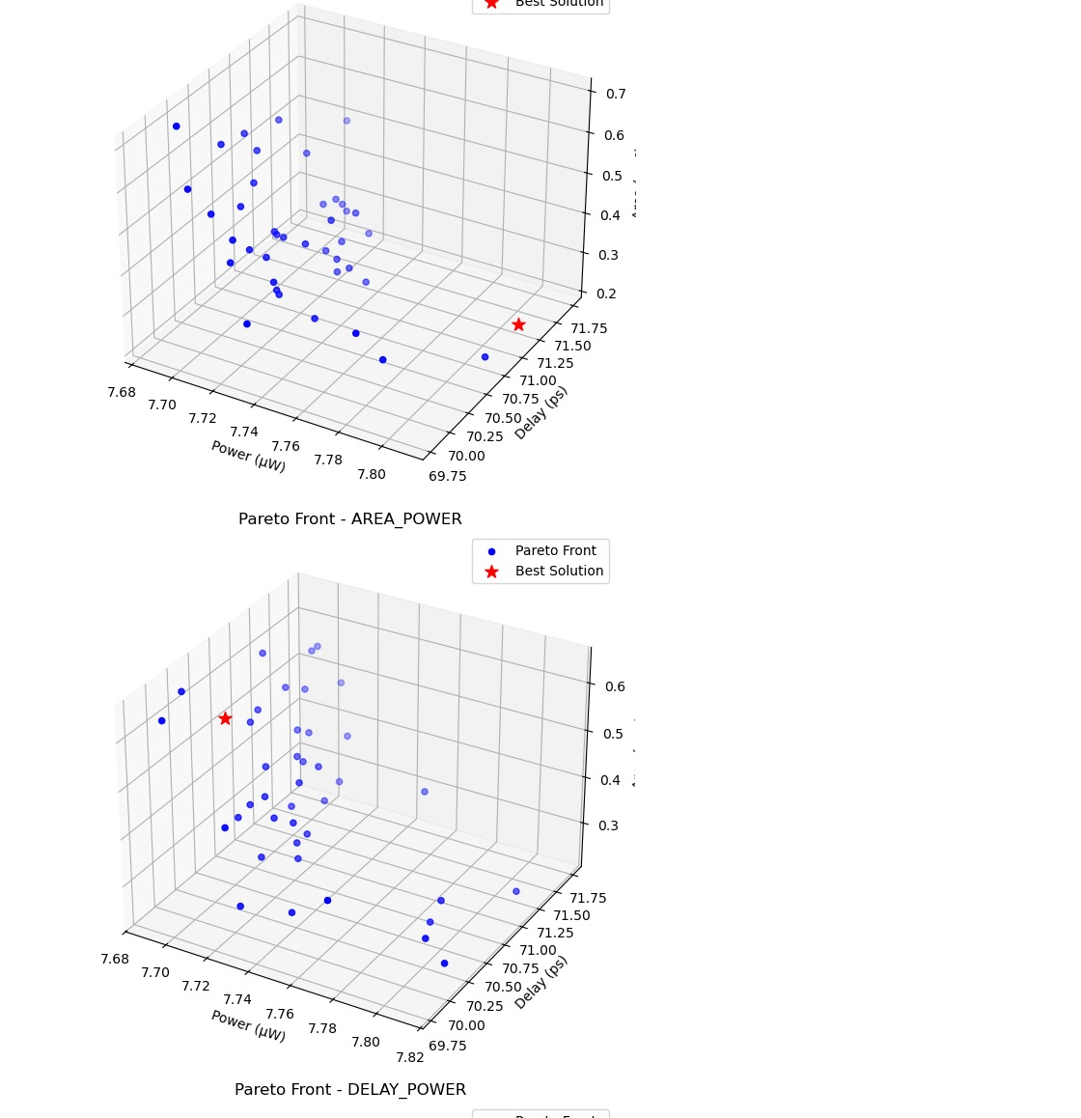
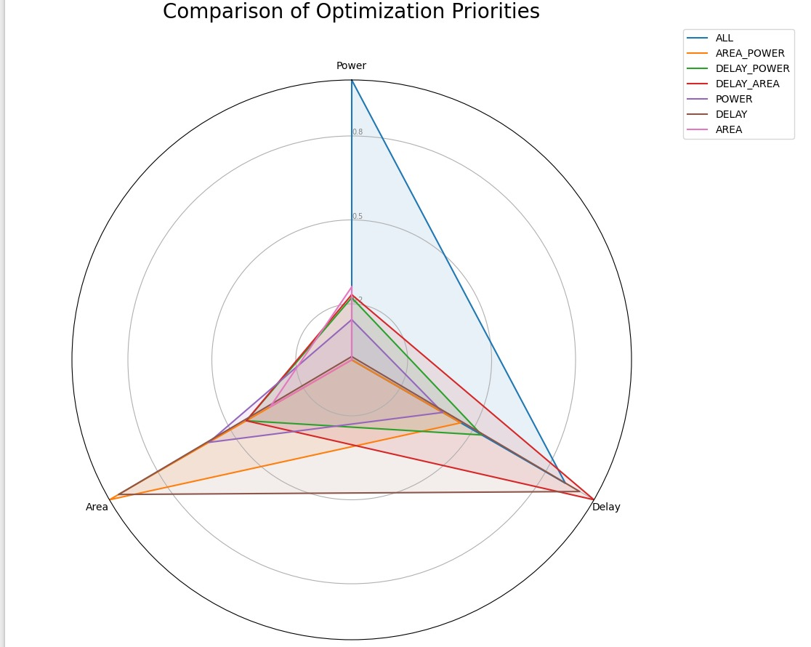
Pareto Optimization for CMOS Inverter

Slide 44
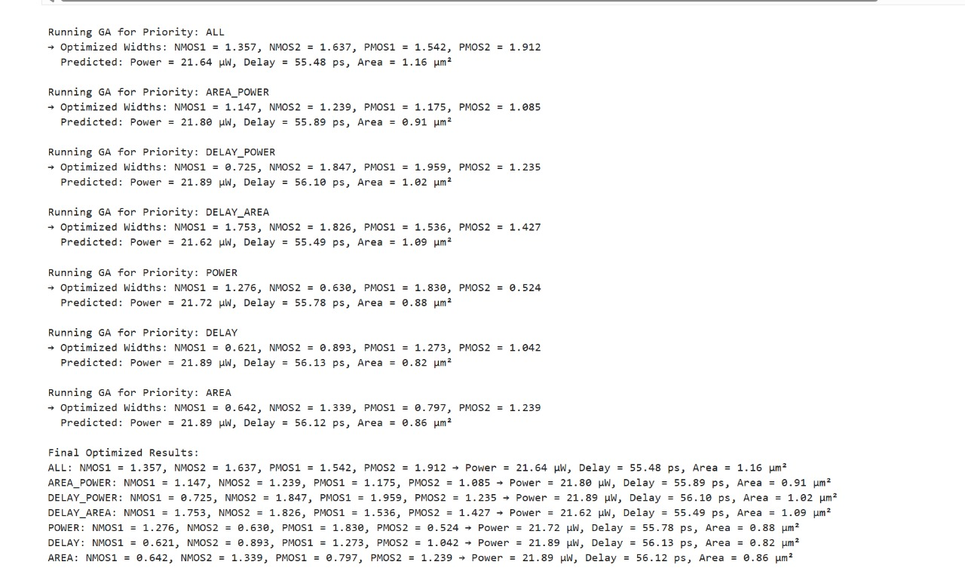
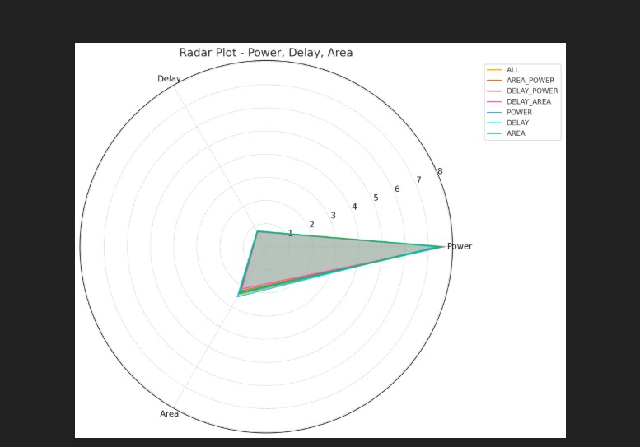
Pareto Optimization for CMOS NAND

Slide 45
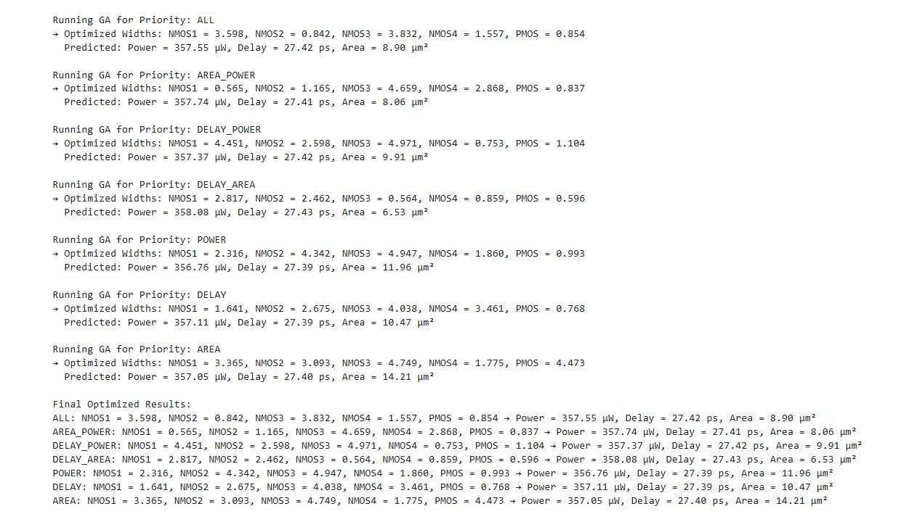
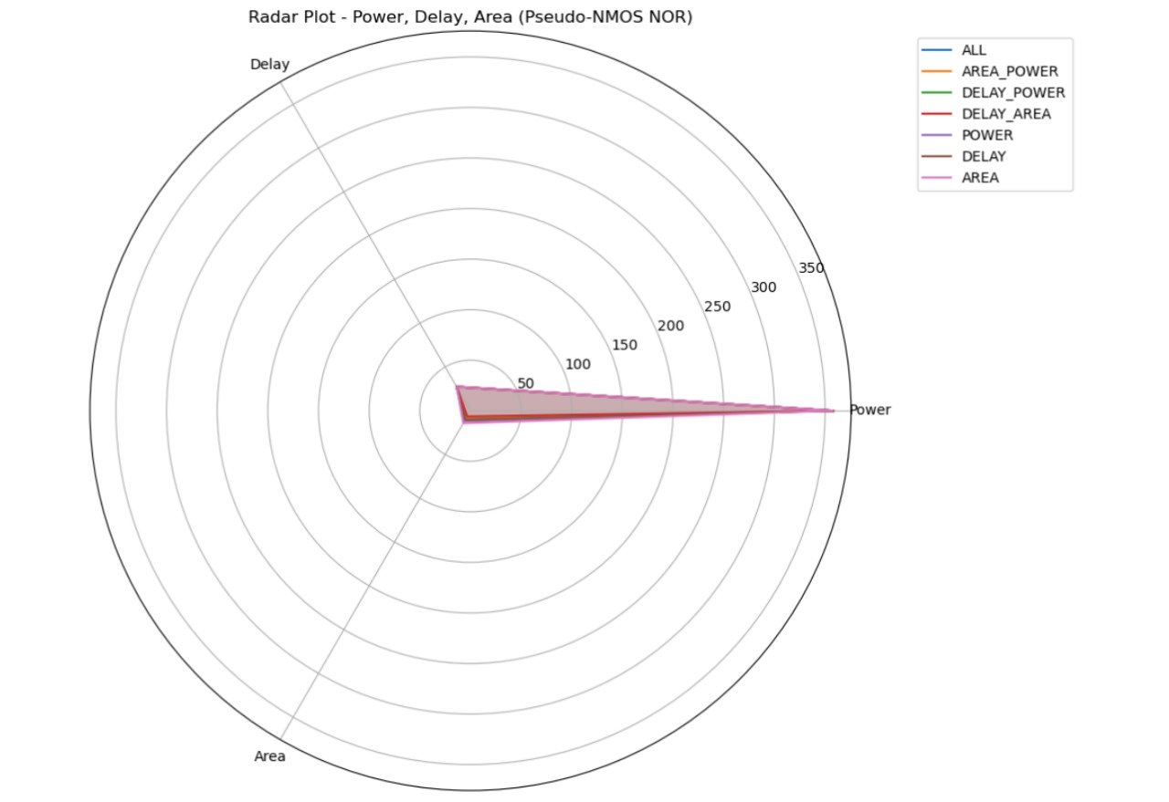
Pareto Optimization for PSEUDO NMOS NOR

Slide 46
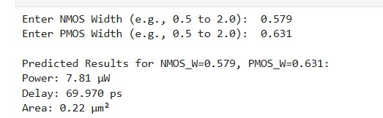
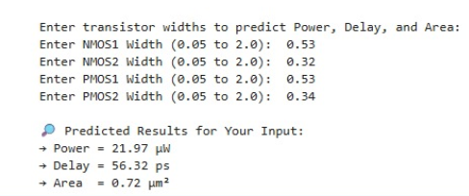

User input for CMOS Inverter :
User input for NAND Circuit :
Here we allow a user to input NMOS and PMOS transistor widths, then uses a pre-trained machine learning model to predict circuit performance. It first checks that the inputs are valid numeric values and fall within defined width limits. The inputs are then scaled using a pre-fitted scaler before being passed to the model for prediction. The predicted values for power, delay, and area are adjusted (if needed) and printed as output, providing quick insight into the circuit’s behavior for the chosen transistor sizes.

Slide 47


STEP-5 :
Predicted values for CMOS Inverter using ML :
Final output for CMOS Inverter in LT Spice :
Here we took the above width values and stimulated Inverter circuit in ltspice and produced below output.
If we compare the predicted power and actual circuit power, we are getting similar values verifying our ML model and GA Algorithm.
Power = I(Avg) * V (V= 1.8 & I=4.22)
=4.22 *1.8
~=7.6189

Slide 48


Predicted values for NAND Circuit using ML:
Final output for NAND Circuit in LT Spice :
Here we took the above width values and stimulated NAND circuit in ltspice and produced below output.
If we compare the predicted power and actual circuit power, we are getting similar values verifying our ML model and GA Algorithm.
Power = I(Avg) * V (V= 1.8 & I=1.16)
=1.16 * 1.8
~=2.88

Slide 49

Predicted values for PSEUDO NOR Circuit using GA:
Final output for PSEUDO NOR Circuit in LT Spice :
Here we took the above width values and stimulated NOR circuit in ltspice and produced below output.
If we compare the predicted power and actual circuit power, we are getting similar values verifying our ML model and GA Algorithm.
Power = I(Avg) * V (V= 0.00016 & I=1.16)
=1.16 * 1.8
~=2.88

Slide 50

Achievements so far:
(i) AI-Driven Optimization
An AI-based framework has been developed to automate transistor sizing. This framework incorporates Machine Learning, Genetic Algorithms, and Reinforcement Learning to systematically optimize circuit parameters. By implementing Pareto Optimization, an effective balance between low power consumption, high speed, and minimal silicon area is achieved, significantly improving the efficiency of CMOS circuits.
Machine Learning
Genetic Algorithms
Reinforcement Learning
Utilized for accurate circuit performance prediction.
Employed for automated transistor sizing.
Used to systematically optimize circuit parameters.
(ii)Data-Driven Modeling
Extensive LTspice simulations were conducted to extract essential circuit parameters such as power, delay, and area. These parameters were then used to train Machine Learning models, allowing for accurate circuit performance prediction without the need for exhaustive simulations. This data-driven approach enhances efficiency and reduces computation time while maintaining accuracy.
1
LTspice Simulations
2
Machine Learning Models
3
Efficiency Enhancement
Extracted essential circuit parameters.
Trained for accurate circuit performance prediction.
Reduced computation time while maintaining accuracy.

Slide 51



(iii) Automation of Transistor Sizing
The implementation of AI-based optimization algorithms eliminated the need for manual tuning. By leveraging evolutionary algorithms, transistor sizing is performed automatically, ensuring optimal PPA trade-offs. This automation significantly improves design accuracy and reduces development time, making the process more efficient than conventional methods.
Automation
Accuracy
Efficiency
Eliminated the need for manual tuning.
Improved design accuracy.
Reduced development time.
Future Scope
Future research will focus on improving the accuracy of AI models by integrating Deep Learning and Neural Networks. Advanced techniques such as hyperparameter tuning and transfer learning will be explored to enhance efficiency. Additionally, the optimization framework will be extended to support advanced CMOS technologies, including FinFETs and SOI. Hardware validation through FPGA and ASIC implementations will be conducted to compare AI-driven designs with real-world silicon performance.
1
Deep Learning
2
Advanced CMOS
3
Hardware Validation
Integrate for improved accuracy.
Compare AI-driven designs with real-world
silicon performance.
Extend optimization framework.

Slide 52




Conclusion
This project successfully demonstrates the effectiveness of AI-driven optimization in VLSI circuit design. By automating transistor sizing using Machine Learning, Genetic Algorithms, and Reinforcement Learning, significant improvements in Power, Performance, and Area (PPA) were achieved. The use of Pareto Optimization ensures optimal trade-offs, leading to more efficient CMOS circuits.
PPA Improvements
Significant gains achieved.
Pareto Optimization
Ensures optimal trade-offs.
Efficient CMOS
Leads to more efficient circuits.

Slide 53
REFERENCE
[1] M. Maghroori and M. Dolatshahi, “Design of low power CMOS VLSI circuits using multi-objective optimization in genetic algorithms,” World Journal of Advanced Research and Reviews, vol. 12, no. 1, pp. 215–224, 2021.
[Online]. Available: https://doi.org/10.30574/wjarr.2021.12.1.0427
[2] S. L. Murali, ``Artificial Intelligence in VLSI Physical Design of Circuits to Optimize Power, Performance and Area (PPA),'' \textit{International Research Journal of Engineering and Technology (IRJET)}, vol. 11, no. 10, pp. 266--271, Oct. 2024. [Online].
Available: https://www.researchgate.net/publication/384928547
What We Have Used:
Machine Learning (ML) in VLSI Design:
Techniques like Neural Networks (NN), Random Forest (RF), and Support Vector Machines (SVM) for PPA optimization. Predicting transistor behavior, placement congestion, and timing bottlenecks.
LTspice for Circuit Stimulation :
Pareto Optimization for Multi-Objective Trade-offs:
Used to balance power consumption, delay, and area utilization. LTspice Circuit Simulations:
Extracting real-time power, delay, and area values for AI training.
We used LTspice to simulate CMOS circuits (Inverter, NAND, NOR) and extract key performance metrics like power, delay, and area. These simulation results were then used to generate datasets for training AI models.

Slide 54
What We Have Learned**:
AI significantly accelerates VLSI circuit design by eliminating the need for repetitive manual simulations and transistor sizing.
Machine Learning models (Random Forest, Neural Networks) can accurately predict key performance metrics—Power, Delay, and Area—from circuit parameters.
Pareto Optimization helps identify the best trade-offs between conflicting objectives, ensuring optimal circuit performance with minimal area and power.
LTspice simulations provide a reliable foundation for generating realistic training data that reflects process variations.
Automation through AI improves design efficiency, reduces development time, and enhances accuracy compared to traditional methods.
Neural Networks offer better generalization for complex circuits, while Random Forests are efficient for smaller datasets and quick predictions.
This approach lays the foundation for scalable, AI-driven optimization frameworks that can be extended to advanced technologies like FinFETs or validated on real hardware (FPGA/ASIC).

Slide 55
THANK YOU

